Slide 1
Теория Информации
В.Н. Ярмолик
Лекция 21
2016

Slide 2
Steganography Main definitions
Steganography is the art and science of hiding messages inside others messages. In Greek, steganography means covered or secret writing. (Stegano=covered graphy= writing).
Cryptography is a distant cousin of steganography. Cryptography scrambles a message so it can not be understood but there is knowledge of a message being there. While steganography's intent is to hide the existence of a hidden message.
The Digital watermarking and fingerprinting of audio and video industries are starting to recognize the possible uses of steganography.

Slide 3
Steganography Main definitions
Steganography (Covered writing / Covert Channels)
Protection against detection (Data Hiding)
Protection against removal (Data Marking)
Captioning
(Document title hiding)
Watermarking
(All data are marked in the same way)
Fingerprinting
(Every data is marked specific)

Slide 4
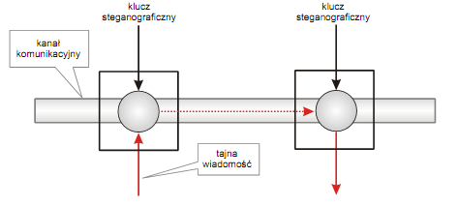
Steganography Main definitions and terms
Cover data (Cover, vessel or container) is the term used to describe the original, innocent message, data, audio, still, video, etc. Embedded data is the information hidden in the cover data. The stego data is the data containing both the cover signal and the embedded information.
Cover medium + embedded message + stegokey =
= stego medium;
Stego medium + stegokey = embedded message

Slide 5
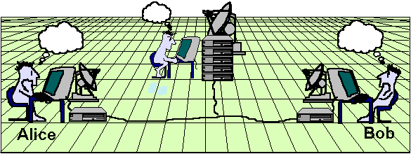
Steganography The prisoner problem
“Hello”
Hello
Hello
Wendy
Alice and Bob are in jail and wish to hatch an escape plan.
Alice's and Bob's communication pass through Wendy.
Alice's and Bob's goal is to hide their ciphertext in innocuous looking way so that Wendy will not become suspicious.
If Wendy is a passive warden he will not do any thing to Alice's and Bob's communication.
If Wendy is an active warden he will alter the data being sent between Alice and Bob.

Slide 6
Steganography Terminology
Alice
Wendy
Bob
Secret
Message
Is Stego Message?
No
Message Retrieval Algorithm
Cover
Message
Embedding Algorithm
Stego Message
Secret Message
Secret
Key
Yes
Secret Key
Suppress Message

Slide 7
Steganography Main definitions and terms
Steganalyst is one who applies steganalysis in an attempt to detect the existence of hidden information. A Steganalyst is a type of cyberforensics. A few other terms to keep in mind are capacity and robustness.
Capacity refers to the amount of information that can be hidden before distortion, or the amount of information that can be inputted into audio with out eavesdroppers to detect.
Robustness is the amount of modification the cover medium can withstand before the hidden information is destroyed.

Slide 8
Steganography History
The earliest records of steganography were recorded by the Greek historian Herodotus. When the Greek tyrant Histiaeus was held prisoner by King Darius in Susa during the 5th century, he had to send a secret message to his son-in law Aristagoras in Miletue. Histiaeus shaved the head of a slave and tattooed a message on his scalp. When the slave's hair had grown long he was dispatched to Miletus.
Another historical example comes from Herodotus as well. During the Greek era they used wax tablets to write text on. Demeratus, a Greek, needed to notify Sparta that Xerxes intended to invade Greece. To avoid capture, he scraped the wax off of the tablets and wrote the message on the underlying wood. He covered the tablet with wax again and it would appear to be blank and unused.

Slide 9
Steganography History
In Ancient Roman, they used invisible ink to write between already written texts. The invisible ink there would use is substances like fruit juices, urine and milk. These substances would darken, and become legible when heated. (Sellars, 2001)
In the 12th century, Saladin, a Muslim leader who fought the Crusaders, often used codes written is Arabic to pass messages to followers. Certain uses of the religious writing from the Koran, which Islam's holy book. Using material derived from the Koran seems to be harmless religious writing, yet holds orders for terrorist. The same use of the Koran is being research today on the Internet.

Slide 10
Steganography History
Kahn tells of a trick used in China of embedding a code ideogram at a prearranged position in a dispatch; a similar idea led to the grille system used in Europe, where a wooden template would be placed over a innocuous text, highlighting an embedded secret message.
During WWII the grille method or some variants were used by spies. In the same period, the Germans developed microdot technology, which prints a clear, good quality photograph shrinking it to the size of a dot.
There are rumors that during the 1980's Margareth Thatcher, then Prime Minister in UK, became so irritated about press leaks of cabinet documents, that she had the word processors programmed to encode the identity of the writer in the word spacing, thus being able to trace the disloyal ministers.
During the "Cold War" period, US and USSR wanted to hide their sensors in the enemy's facilities. These devices had to send data to their nations, without being spotted.

Slide 11
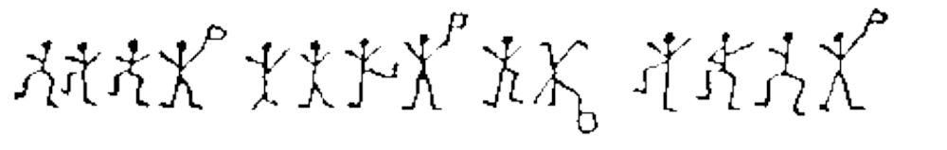
Steganography Early Steganography
Pictographs: e.g., Sherlock Holmes’s Dancing Men.
“Come Here At Once”

Slide 12
Steganography Null-Cipher
Message sent by a German spy during World war-I:
PRESIDENT’S EMBARGO RULING SHOULD HAVE IMMEDIATE NOTICE. GRAVE SITUATION AFFECTING INTERNATIONAL LAW. STATEMENT FORESHADOWS RUIN OF MANY NEUTRALS. YELLOW JOURNALS UNIFYING NATIONAL EXCITEMENT IMMENSELY.
PRESIDENT’S EMBARGO RULING SHOULD HAVE IMMEDIATE NOTICE. GRAVE SITUATION AFFECTING INTERNATIONAL LAW. STATEMENT FORESHADOWS RUIN OF MANY NEUTRALS. YELLOW JOURNALS UNIFYING NATIONAL EXCITEMENT IMMENSELY.
Pershing sails from NY June I.

Slide 13
Steganography Computer Steganography
Computer Steganography is based on two principles.
  The first one is that the files containing digitized text, images or sound can be altered to a certain extend without loosing their functionality.
  The other principle deals with the human inability to distinguish minor changes in image color or sound quality, which is especially easy to make use of in objects that contain redundant information, be it 16-bit sound, 8-bit or even better 24-bit image. The value of the least significant bit of the pixel color won’t result in any perceivable change of that color.

Slide 14
Steganography Textual Staganography
Dear Friend ; We know you are interested in receiving cutting-edge announcement . If you are not interested in our publications and wish to be removed from our lists, simply do NOT respond and ignore this mail ! This mail is being sent in compliance with Senate bill 1627 ; Title 3 , Section 305 . This is NOT unsolicited bulk mail . Why work for somebody else when you can become rich within 14 days . Have you ever noticed society seems to be moving faster and faster and most everyone has a cellphone ! Well, now is your chance to capitalize on this ! WE will help YOU decrease perceived waiting time by 130% plus sell more . You can begin at absolutely no cost to you ! But don't believe us . Mr Jones who resides in Georgia tried us and says "I was skeptical but it worked for me" . We are licensed to operate in all states ! For God's sake, order now ! Sign up a friend and you'll get a discount of 90% . God Bless !
Text file with embedded message “Steganography” (www.spammimic.com)

Slide 15
Steganography Textual Staganography
A textual use of steganography can be outlined by technique called Brassil et al. Brassil and others are concerned of the illegal distribution of documents, that include people you are not paying royalties to original author and use documents that are have a copyright. Brassil designed a method of marking printable documents with a unique codeword and not visible to most. This is basically a form of watermarking. The code words could be a binary number that is embedded in the document by altering particular textual features. There are 3 specific methods he designed; line-shift coding, word-shift coding, and feature coding.
Line-shift coding is a method that moves the vertical text line making the document unique. For example one could take the original document created and move every second line 1/300 of an inch up or down. This method is more detectable than the others.

Slide 16
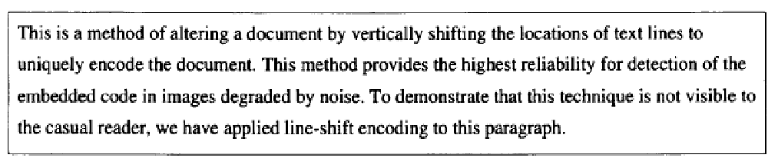
Steganography Textual Staganography
Line-shift coding is a method that moves the vertical text line making the document unique. For example one could take the original document created and move every second line 1/300 of an inch up or down. This method is more detectable than the others.

Slide 17
Steganography Textual Staganography
Word-shift coding embeds a codeword into a document by shifting the horizontal locations of words within text lines, while maintaining natural spacing appearance. This method is only applicable to documents with variable spacing between adjacent words. One way this technique can be used is by taking each text-line and locating the largest and smallest spaces between words. To code, the largest spacing is reduced by a certain amount and the smallest is extended by the same amount. This maintains the line length and there is little visible change.

Slide 18
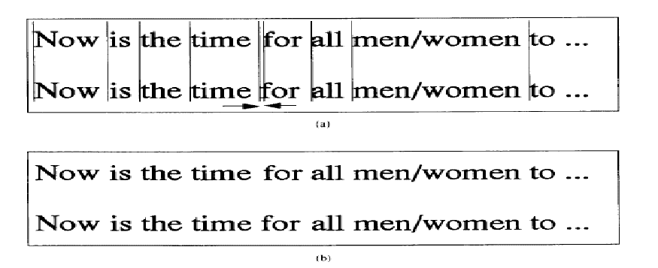

Steganography Textual Staganography
Embedded message is 01000001:
–0,5 → 0; +0,5 → 1.

Slide 19
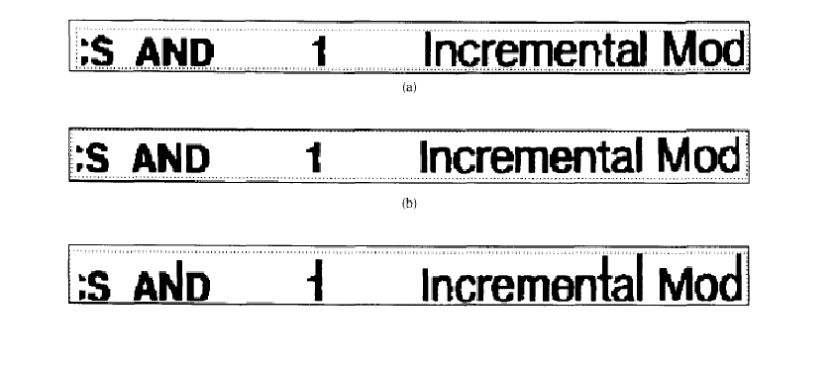
Steganography Textual Staganography
Feature coding is Brassils third method of watermarking. The author would use this technique by altering certain text features. An example would be extending or shortening the upward vertical endlines of letters such as t, l, b, d, h, or altering the endline lengths.

Slide 20
Steganography Lexical Staganography
Textual steganography can also be done through alternative methods, for example syntactic and semantic methods. Syntactic is a method that utilizes punctuations and contradictions. Another name for Semantic is called substitution. This method of concealing hidden messages is a distant form of steganography. For example I could say the apples in Washington are known to be the best. When you read this email you know that the word apple means bomb and "know to be the best" refers to a major landmark. This technique is almost impossible to detect and retract the hidden message.

Slide 21
Steganography Lexical Staganography
Lexical steganography is the encoding of data in blocks of text on the lexical, or word, level. For instance, pretend that you are a secret agent and that I am your faithful husband, waiting pensively at home for news that you are safe. I might receive a letter from you saying, "Dear Keith - I am doing fine. I can't tell you where I am, because it's top secret, but be sure that I'm just dandy." How can I know if this is really true, or if you're being forced to write this by the Evil Enemy? Well, one way to tell would be if we had some preexisting agreement that if you start your letter with, "I am doing fine," it means you're doing fine, but if you start with, "I am doing well," it means you're in trouble and I'd better send James Bond in to save you.
Through this sort of method, you've encoding information without it being directly visible on the surface. Both, "I am doing fine," and "I am doing well," are reasonable sentences and would likely pass through the E.V.I.L. censors, but we can take advantage of this redundancy in the English language to encode information on a different level.

Slide 22
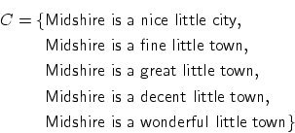
Steganography Lexical Staganography
Lexical Steganography
The most straightforward subliminal channel in natural language is probably the choice of words. On the word-level, meaning is traditionally linked to the lexical relation of synonymy. For example, consider the following set of covers:

Slide 23
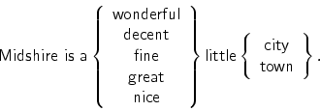

Steganography Lexical Staganography
We can use synonymy to encode ten states in the above sentences, since two information-carrying symbols are available, one of which can take on five values, whereas the other one can take on two values. The first is the choice for either wonderful, decent, nice, fine or great and the other is for either city or town:
We call sets of words that can be used interchangeably synonymy sets.

Slide 24




Steganography Lexical Staganography
A mixed-radix number is one way to encode a secret state in a sentence, if we think of state in numeric terms. Mixed-radix numbers can be written using positional notation in the following way:
for . The numeric interpretation of a mixed radix number is
Given the bases of an n-digit mixed-radix number
we can always use this numerical identity to uniquely write each number in the range from 0 to as the sequence where

Slide 25
Steganography
Lexical Steganography
A final category of data hiding in text involves changing the words themselves. Semantic methods are similar to the syntactic method. These methods assign two synonyms primary or secondary value. For example, the word “big“ could considered primary and “large“ secondary value. When decoding, primary wird will be read as ones, secondary words as zero. Word webs such as WordNet can be used to automatically generate synonym tables. For example, the choice between “propensity“, “predilection“, “penchant“ and “proclivity“ represents two bits of data. Contrexample “Too“ may replaced with “also“ sometimes, but for the sentence “This bed is too big“ it clearly cannot be. The reason is that adv. too has 2 senses and that is why belongs to two synonym sets {Excessivly, Overly, Too} and {Besides, Too, Also, Likewise, As well}. This example shows that the distinct condition should be determined for the set of “interchangeable“ words. Consider three words XXX, YYY, and ZZZ:

Slide 26
Steganography Lexical Staganography
Case 1. XXX and YYY are both single-sensed and are considered interchangeable;
Case 2. XXX and YYY are doubly-sensed, as such: S1:{XXX, YYY}; S2:{XXX, YYY, ZZZ}. We can still allow unconditional substitution between the two words.
Case 3. YYY is doubly-sensed, and YYY single-sensed: S1:{XXX, YYY}; S2:{XXX, ZZZ}. No substitution can be made here for any word.
Case 4. XXX and YYY are both single-sensed, and they are in the same synonym set {XXX, YYY}, but YYY has a space in it. We ignore these and do not allow them to be the target of substitutions.

Slide 27
Steganography Lexical Staganography
The second problem associated with the naive algorithm is its inability to take advantage of the extra information-carrying capacity in regions of a synonym set beyond the highest power of 2. To take advantage of absolutely all of the information-carrying capacity in a document. The Ideal Coding can be used.
Let a document containing the word AAA, MMM, and WWW, where the relevant interchangeability sets involved are: {AAA(0), BBB(1), CCC(2)}; { MMM(0), NNN(1), OOO(2 ),PPP(3), QQQ(4)}; {WWW(0), XXX(1), YYY(2)}. By replacing the locations containing AAA,MMM, and WWW with some member of their interchangeability set, we can achieve 3×5×3=45 different states, which enough to store 5 binary digits.

Slide 28
Steganography Lexical Staganography
To mapping of these binary digits to states of the document is simple. By using the numbers tagged to each set element, can treat the document as a multi-base number – that is, its last digit signifies the “one’s place” and can run from 0 through 2, its middle digit can run from 0 to 4, and the first digit may nave the value starting from 0 to 2. The standard counting sequence in binary thus maps logically to our “counting sequence” for document stays as such:
Binary Stego-Digits | 00000 | 00001 | 00010 | 00011 | 00100 | ... | 01110 | 01111 | ...
Mixed-Base State Code | 000 | 001 | 002 | 010 | 011 | ... | 042 | 100 | ...

Slide 29
Steganography Mimicry
Another wide spread lexical steganography in mimicry. According to this approach the real like text is generated which is described in Context Free Grammar (CFG).
Grammar CFG – is one of formal method to describe any language and consists from words phrases and rules.
Mimicry design the binary tree based on particular CFG with the decision nodes and construct the text according to the embedded message bits.
Example: Embedded message is 10101 and binary tree is as the follows.

Slide 30
Steganography Mimicry
Старт → существительное
существительное → Илья || Иван
глагол → поехал куда || пошел куда
куда → на работу, чтобы зачем. || домой, чтобы зачем.
зачем → забрать что || взять что
что → деньги || одежду.
Start → a noun
Noun → Ilya || Ivan 0||1
Verb → has droved where || has gone where 0||1
Where → for work, that what for || home, that what for 0||1
What for → to take away that || to take that 0||1
That → money || clothes. 0||1

Slide 31
Steganography Mimicry
Decision nodes | Message bit | Result after message 1010 has been embedded
Старт | – | Старт → существительное
существительное | 1 | существительное → Иван
Иван глагол | 0 | глагол → поехал куда
Иван поехал куда | 1 | куда → домой, чтобы зачем
Иван поехал домой, чтобы зачем | 0 | зачем → забрать что
Иван поехал домой, чтобы забрать что | 1 | что → одежду

